Slide 1


Slide 2
Chapter 3 Wired and Wireless Networks
Network and Security Fundamentals

Slide 3
Objectives
Describe the development of wired networks
Examine Wireless network concepts
Describe Ethernet technologies and media
Compare twisted pair and fiber-optic cables

Slide 4
Chapter 3 - Wired and Wireless Networks
What is Ethernet ? Ethernet is the most widely used LAN technology in the world today and has become a staple in primarily all wired networks. Since its inception in the mid-1970s, wired networks have become faster and more robust. Wired networks continue to evolve as engineers and developers continue to develop faster Ethernet technologies to support the dynamic nature of networks.

Slide 5
Chapter 3 - Wired and Wireless Networks
Ethernet Timeline
1876: The creation of the telephone was key in developing wired communication
1964: Optical fiber was created, and better communication was made possible.
1970: Technology consisting of twisted copper and a coaxial-based transport system was established
1972: Bob Metcalfe created an experimental Ethernet network to connect the Xero Alto
to other devices (servers, printers)
1980: Developers and researches created the groundwork for Digital Subscriber Line (DSL)
1985: Ethernet became an Institute of Electrical and Electronics Engineers (IEEE) standard
2000: Broadband technology was made accessible to the general public

Slide 6
Chapter 3 - Wired and Wireless Networks
In Ethernet LANs, there are primarily two types of twisted-pair cables referred to as unshielded twisted pair (UTP) and shielded twisted pair (STP). Both have their advantages and disadvantages:
UTP- UTP stands for unshielded twisted pair and is very common in most Ethernet networks.
STP- stands for shielded twisted pair and is not as common as UTP cables.

Slide 7

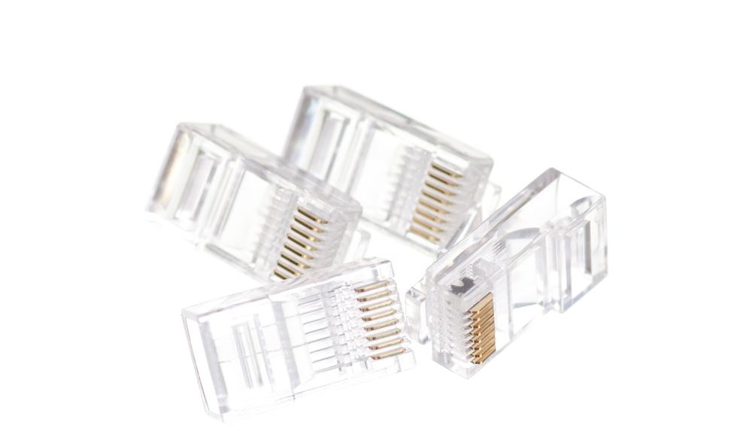
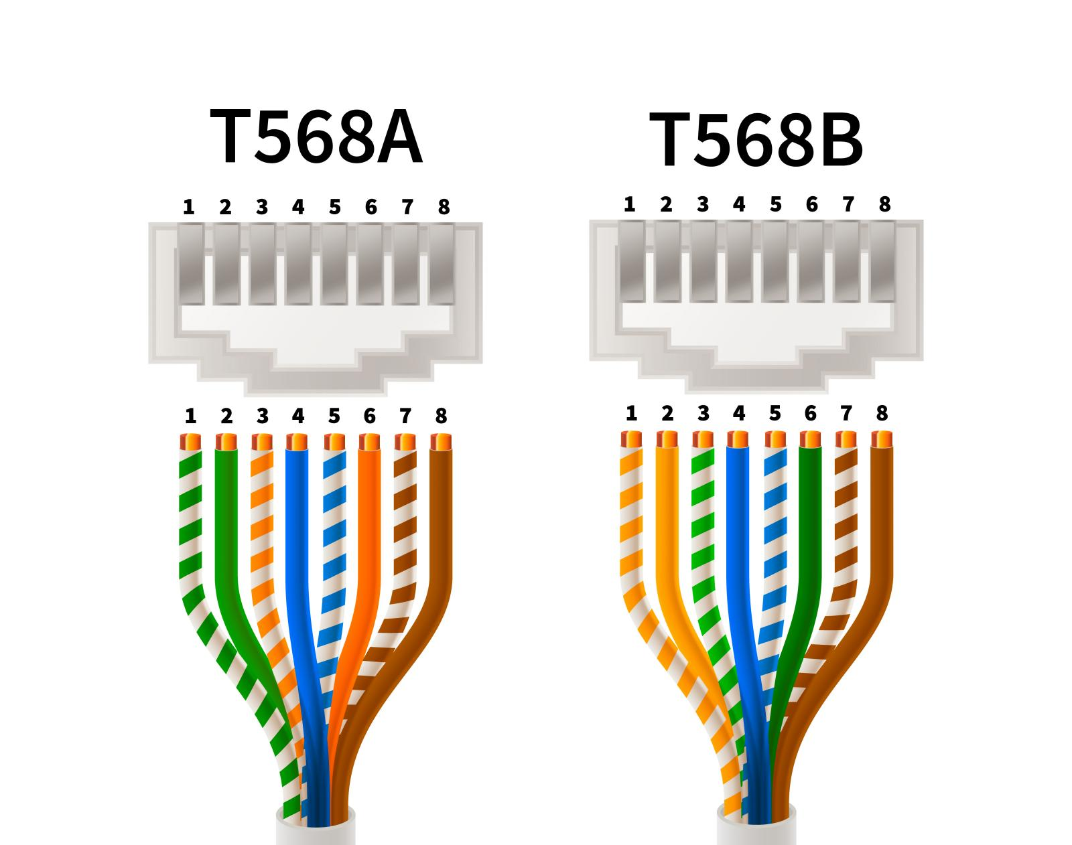
Chapter 3 - Wired and Wireless Networks
When connecting or terminating the twisted-pair cable onto the connector interface two wring schemes are used: T568A and T568B. These two wiring schemes are both widely accepted and determine how the twisted pair will be terminated on the RJ45 connector based on the color and the pins.

Slide 8
Chapter 3 - Wired and Wireless Networks
There are several categories of twisted-pair cables; each category is defined by the maximum speed they can handle without having any interference or crosstalk. The numbers of the categories signify the number of twists on each wire.
CATEGORY | SPEED | DISTANCE/LENGTH | BANDWIDTH | APPLICATION
Category 3 | 10 Mbps | 100 M | 16 MHZ | 10Base-T 100Base-T4
Category 5 | 100 Mbps | 100 M | 100 MHZ | 100Base-TX 1000Base-T
Category 5e | 1 Gbps | 100 M | 100 MHZ | 100Base-TX 1000Base-T
Category 6 | 10 Gbps | 100 M | 250 MHZ | 10GBase-T
Category 6a | 10 Gbps | 100 M | 500 MHZ | 10GBase-T
Category 7 | 10 Gbps | 100 M | 600 MHZ | 10GBaseT 1000Base-T
Category 8 | 40 Gbps | 100 M | 1600–2000 MHZ | 40GBase-T 1000Base-T

Slide 9
Chapter 3 - Wired and Wireless Networks
Wireless IEEE Standards
IEEE STANDARD | YEAR RELEASED | FREQUENCY | MAXIMUM DATA RATE
802.11a | 1999 | 5 GHz | 54 Mbps
802.11b | 1999 | 2.4 GHz | 11 Mbs
802.11g | 2003 | 2.4 GHz | 54 Mbps
802.11n | 2009 | 2.4 GHz and 5 GHz | 600 Mbs
802.11 ac | 2014 | 2.4 GHz and 5 GHz | 1.3 Gbps
802.11 ax | 2019 | 2.4 GHz and 5 GHz | 10–12 Gpbs

Slide 10
Chapter 3 - Wired and Wireless Networks
Wireless networks use two bands or frequencies—2.4 GHz and 5 GHz to carry wireless data. Depending on your wireless router, it may transmit on one band or both bands. If your router only transmits on the 2.4 GHz band, it is considered a single-band router. If your wireless router transmits on both the 2.4 GHz and 5 GHz bands, it is considered a dual-band router. The 2.4 GHz band is a very popular band and is used by several other devices.
Another difference in the 2.4 GHz and 5 GHz bands are the number of available channels. Every wireless device operates on a (RF) channel identified by numbers. The 2.4 GHz band has 11 channels to choose from but only three are nonoverlapping (1, 6, 11). However, the 5 GHz band has many more channels and has 25 nonoverlapping channels.

Slide 11
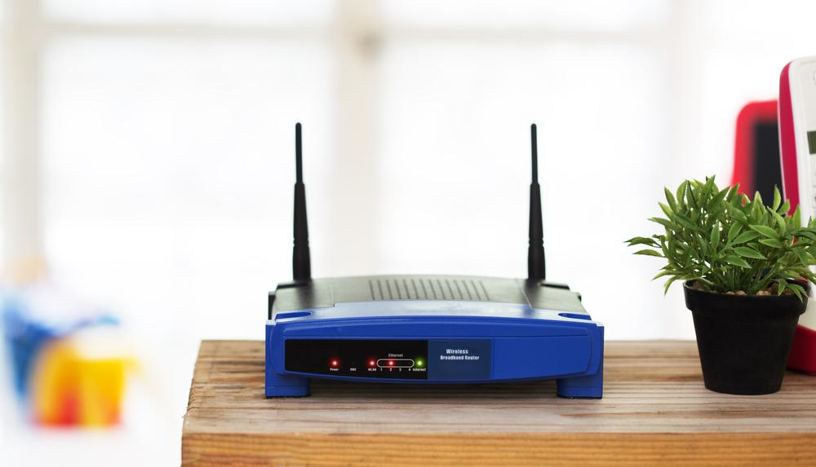

Chapter 3 - Wired and Wireless Networks
In a corporate LAN, the most common method to connect to a wireless network is via a WAP. Most WAPs are in ceilings and are connected by Ethernet cables that attach to a switch. The location of a WAP on a corporate network is very important in order to ensure all wireless devices have coverage. WAPs are also known as base stations.
In a home LAN, the most common method to access a wireless network is a wireless router. Most wireless routers offer coverage of about 100 to 200 feet depending on the 802.11 standard and are omnidirectional. It’s important to remember that doors and walls can block a wireless signal. Therefore, a wireless router should always have a clear line of site to the connecting device. It’s often very common to purchase repeaters or range extenders if your home is very large.

Slide 12

Chapter 3 - Wired and Wireless Networks
The most common modes of wireless networks are Ad-Hoc mode and Infrastructure mode. When using Ad-Hoc mode on a WLAN, devices communicate directly with each other rather than connecting to an access point. Ad-Hoc mode is considered a decentralized peer-to-peer network. This wireless mode is sometimes referred to as peer-to-peer mode. Ad-Hoc mode is quick to set up and very inexpensive. However, as more users join an Ad-Hoc network, the performance decreases. Security may also be an issue, unless you are comfortable with the various wireless devices communicating in your network.
Infrastructure mode is used most often with organizations and large companies. This mode is a centralized mode of communication. In Infrastructure mode, different devices connect to an access point and not directly to each other. A WAP is a layer 2 device and acts as a bridge between wireless traffic and wired traffic.

Slide 13
Chapter 3 - Wired and Wireless Networks
An SSID identifies specific wireless networks and allows wireless devices to connect to a specific base station or wireless router. In order to connect to the client, device must be configured with the same SSID. An SSID is sometimes referred to as the WLAN network name and is a unique character string used to classify the WLAN.
A Basic Service Set (BSS) is group of wireless network devices that use the same access point. The Basic Service Set Identifier (BSSID) is a unique 48-bit label which is also the access point’s physical Media Access Control (MAC) address. A service set can be extended by adding more access points, which is called an Extended Service Set (ESS). The shared network name is referred to as the Extended Service Set Identifier (ESSID). In an ESSID, every access point broadcast the same SSID to its users. When using an ESSID, a client can move from one access point to another or from one service set to another and never know the difference.

Slide 14
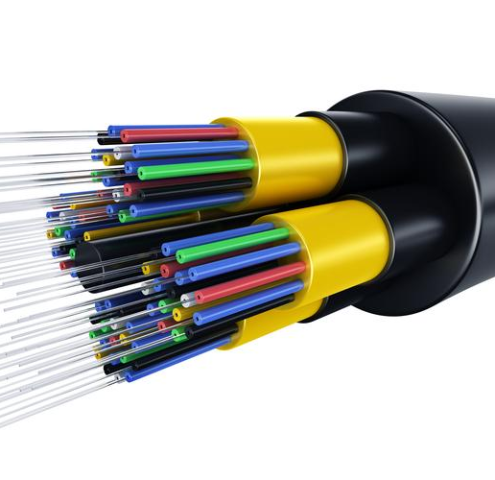
Chapter 3 - Wired and Wireless Networks
A fiber-optic cable is made up of a center glass core surrounded by several layers of protected materials. The core is a strand of extremely thin glass that is approximately the same size as a human hair. It is the medium used to transmit light pulses. The outer layer of a fiber cable is referred to as a jacket and is made of polyvinyl chloride (PVC) or Teflon. The second layer is called the buffer and provides protection from physical damage. The layer around the fiber core is called cladding. Cladding is made of glass or plastic and reflects light back to the core in various patterns, which are determined based on the transmission mode.

Slide 15
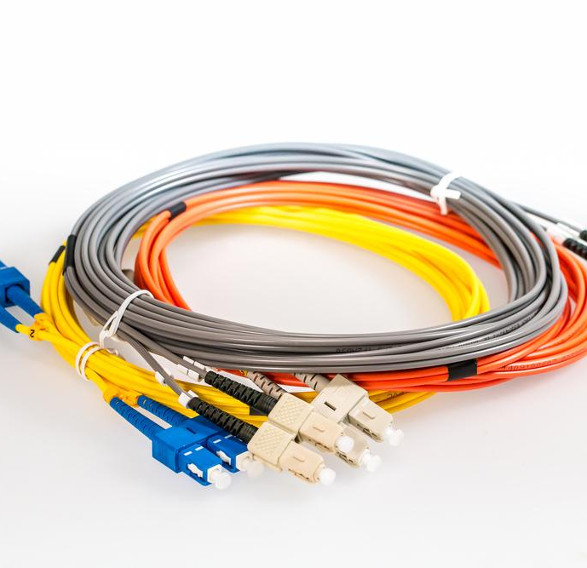
Chapter 3 - Wired and Wireless Networks
There are two types of propagation modes in fiber-optic cables, which are single-mode and multimode. Single-mode optical fiber (SMF) is designed to carry light with a single mode, which means light travels in the same way or same pattern which gives us a single ray of light. Single-mode fiber has several advantages including high transfer rates over long distances, no dispersion of light as signal travels, and can carry signals several miles before repeating.
Multimode optical fiber is mostly used for communicating over short distances like on a campus or within a building. Light waves are dispersed into numerous paths or modes as they travel through the cable core. Multimode links can reach data rates up to 100 Gbps.

Slide 16
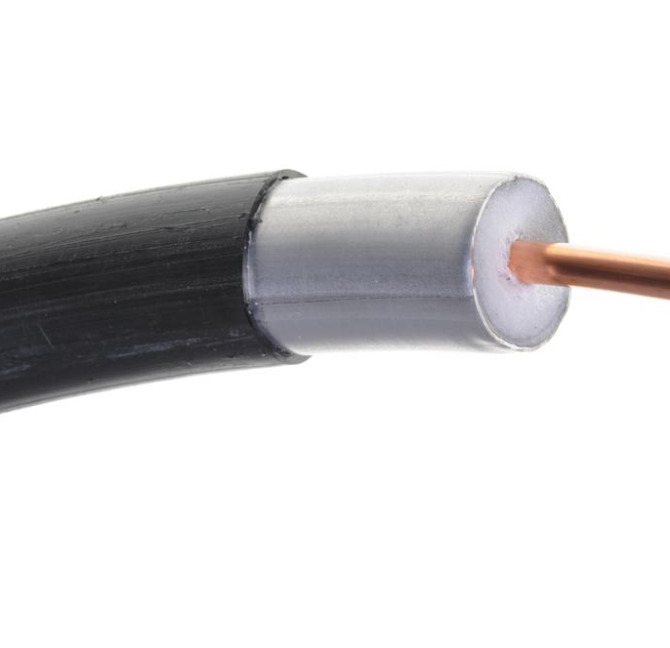
Chapter 3 - Wired and Wireless Networks
Coaxial is often used in broadband Internet, high-speed computer data busses, cable TV, and Ethernet networks. There are numerous coaxial cable specifications, however, most coaxial cables us an RG number. RG stands for Radio Guide and helps to specify various coaxial cables.

